Slide 1
إدارة المشروعات Projects Management
د. باسم ممدوح الحلوانى
Lecture 3
Scope Management

Slide 2
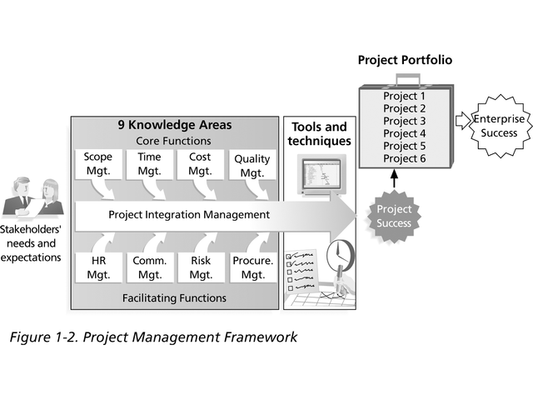
Remember: The 9 Knowledge Areas
There are nine knowledge areas a project manager should know about.

Slide 3
Scope Management
Understanding and managing scope is the first and most important work to be done on a project.
Defining and managing scope enables the project manager to ensure that only the required work will be done – no more, no less.
It is important the project scope is agreed upon by the key stakeholders and approved by the project sponsor.
Processes used to identify
all the work required
&
only the work required
to successfully complete the project

Slide 4
Scope Management
Defining scope starts in the Initiation (or concept) phase of the project and is built upon, reviewed and modified as the planning phase progresses.
Developing
(Planning)
Concept
Planning
Executing
Controlling
Finishing
(Closing)

Slide 5
Scope Management
The concept phase will typically contain a high level scope statement which provides an outline of what is expected to be done in the project.
Concept
The High level scope, cost , and time estimates enable the project sponsor to make a decision to whether provide funding and approval for the project to move forward to the planning phase or not.
Because the complexity of the project and delivery options are often not uncovered until the planning stage, the project sponsor will often give approval for ‘seed’ funding, which covers only the planning phase.
At the end of the planning phase, the project will be re-evaluated, with a more detailed scope and more accurate estimates of time and cost.
Developing
(Planning)
Planning
funding for the rest of the project will be approved if the sponsor believes that it should still go ahead.

Slide 6
Scope Management Plan
How will requirements be gathered and documented?
How will changes to scope be controlled?
How will scope management processes be reviewed?

Slide 7
Scope Management Processes
Concept | Developing | Executing | Controlling
1. Collect Requirements
2. Define Scope
3. Create WBS
4. Verify Scope
5. Control Scope
WBS = Work Breakdown Structure

Slide 8
Scope Management Processes
1. Collect Requirements
Collect Requirements is the process of defining and documenting stakeholders’ needs and managing customer expectations meet the project objectives.
Requirements become the foundation of the WBS.
Cost, schedule, and quality planning are all built upon these requirements.
Failure to fully analyze, document and verify the customer requirements can result in a lot of costly changes later on in the project, or in the worst case can result in project cancellation.

Slide 9
Scope Management Processes
1. Collect Requirements
How requirements be gathered and documented will depend on the type of project.
Common methods of gathering can include :
User interviews,
Business process analysis and
User workshops.
Group creativity techniques
Questionnaires and surveys
Observations
Requirements may be documented in various ways, depending on your industry but are commonly a:
List of the required functionality and
List of attributes of the required product or service.
It is very important that initial requirements are understood so that the final design provides the functionality and attributes desired by the customer.

Slide 10
Scope Management Processes
2. Scope Definition
is the process of developing a detailed description of the project and product.
The preparation of a project scope statement is critical to project success.
The scope statement must initially contain clear descriptions of :
Project Goal:
The overall purpose of the project , which is a high level statement of the project purpose e.g. To build a swimming pool in the back yard.
Project Objectives:
What the project is aiming to achieve (itemise key objectives) which are used to measure the project success.
The objectives of what the project is to achieve must be SMART
Specific – Measurable - Achievable and Agreed - Relevant - Timely

Slide 11
Scope Management Processes
2. Scope Definition
The scope statement must initially contain clear descriptions of :
Project Deliverables:
What products/services be produced to achieve objectives.
A deliverable is tangible as well as verifiable.
To be verifiable, the deliverable must meet predetermined standards for its completion, such as design specifications for a product (like a the new pool) or it may be a document like a user guide with pre-defined content.
Examples of deliverables for a project to build a new swimming pool:
Swimming pool (built to specification)
Pool cover
Warranty documents
Maintenance manuals
Scope Statement : must also defines what work will be done to achieve the objectives and deliverables

Slide 12
Scope Management Processes
2. Scope Definition
Scope Statement Example
Swimming Pool Construction
In Scope | Out of Scope
Pool (built according to specification) | Landscaping around pool
Pool cover | Pool heater
Warranty (2 years)
Maintenance manual

Slide 13
Scope Management Processes
2. Scope Definition
The scope statement must initially contain clear descriptions of :
Scope Statement :
Must defines what work will be done to achieve the objectives and deliverables
what work will not be included in the project (but could be assumed by the customer to be included) (((Out of Scope)))
For example in your swimming pool project, you may wish to list a pool heater as being out of scope in order to ensure that your customer clearly understands that this is an optional extra.
Other sections to include in your scope statement
Project Constraints
Project Assumptions

Slide 14
Scope Management Processes
2. Scope Definition
Other sections to include in your scope statement
Project Constraints
Project Assumptions
A constraint is something that will happen whether you like it or not.
It will have a 100% chance of occurring unless something is done to change the situation.
Examples of constraints may be a fixed budget or the number of resources available to you.
An assumption is what you assume to be true but there is a risk that it may not be
Example, You may assume that there will be no rock to excavate when you dig the hole for the pool.
Risk: you may need special equipment and more time if you strike rock.

Slide 15
Scope Management Processes
2. Scope Definition Benefits
The benefit of a well defined scope statement are:
Provides a basis for defining work to be done and resources needed
Improved accuracy of project estimates because there is less likelihood that something has been forgotten
Enables review and verification and approval of scope by stakeholders
Creates a baseline against which later changes to be defined and controlled

Slide 16
Scope Management Processes
3. Create Work Breakdown Structure (WBS)
WBS is a tool used to break projects down into manageable pieces.
It is the start of the planning process (usually called the 'foundation' of project planning.
A WBS is the decomposition or dividing of the major project deliverables (i.e., scope) into smaller and more manageable components.
The WBS is a deliverable-oriented hierarchical decomposition of the work to be executed by the project team to accomplish the project objectives and create the required deliverables.
There is another tool called a Product Breakdown Structure (PBS), which comes before the WBS and breaks a project down into outputs (products) needed to complete the project.

Slide 17
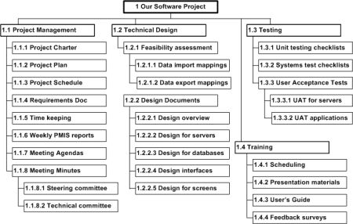
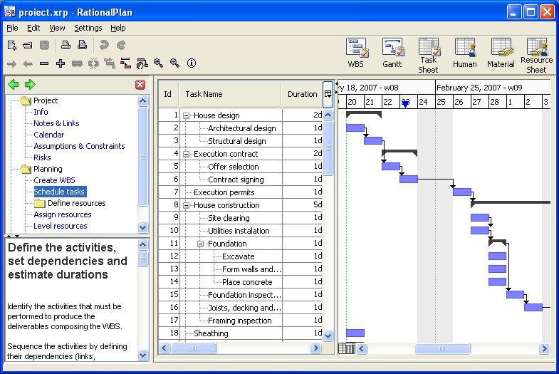
Scope Management Processes
Next lecture
WBS Inputs/Outputs, Benefits, and How to create it

Slide 18
Thank you for Listening

